Slide 2



Slide 3

Agenda
Intro to LangChain Video by Ricky Pirruccio
Intro and Updates: Colin McNamara
VSCode + Cline + MCPs + LangGraph : Colin and Ricky
Image Generation – Cloud and Local : Colin and Karim
After Party: The Tavern, right around the corner on 12th and Lamar

Slide 4
Thanks to our Supporters
Meeting Space– Center for Government and Civil Service
Food and Drink – LangChain AI
Systems, Tokens – Always Cool Brands
Tonight's Volunteers – Setup and Teardown
Community – Sharing learning, one showcase at a time

Slide 5
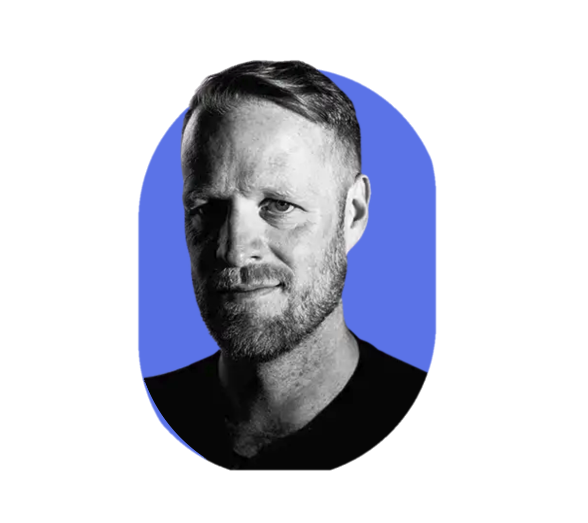

HI , I’m Colin McNamara
Entrepreneur: Co-founder of Always Cool Brands, focusing on private-label products and health-conscious goods.
LangChain Ambassador: Recognized by Harrison and the team for work building our community in Austin
Founder Austin LangChain AIMUG: Learning in the open with a 900+ member AI community in Austin.
10% Developer: Former Cloud Infrastructure leader with experience in hyper-scale cloud building, operations, engineering, and design.
Veteran Advocate: U.S. Marine Helping Fellow Veterans Succeed
LinkedIn:

Slide 6
Who we are
1000+ Members Strong: Connecting Austin’s tech, creative, and business leaders passionate about AI.
Learning in the Open: Leaning AI through the Lense of LangChain, pulling the ecosystem together.
40-50 Active Attendees per Meeting: A mix of local innovators, enthusiasts, and early adopters.
Supportive & Engaged Community: A well-balanced Discord that’s "useful, but not overwhelming."

Slide 7
Learning in the Open – "Be Cool to Each Other" ✌️
Respect & Inclusivity: Our only rule is simple: “Be cool to each other, don’t be gross.”
AI Enthusiasts of All Levels Welcome: We celebrate diverse perspectives and unique paths in AI.

Slide 8
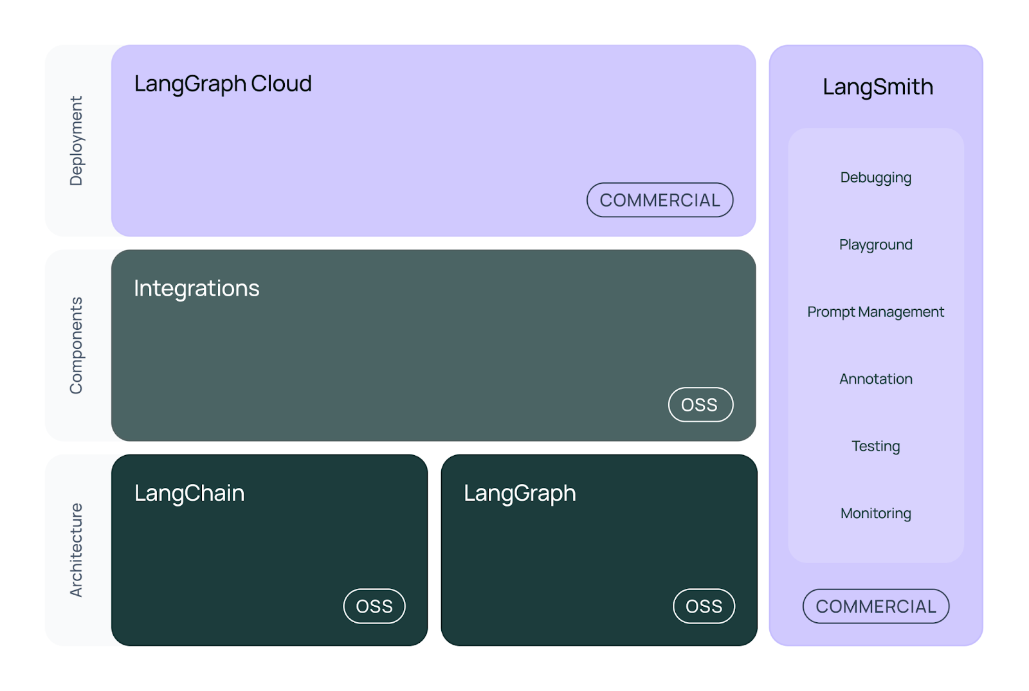
LangChain – a Thread Connecting the Ecosystem

Slide 9
News and Updates- LangChain Interrupt Conference
Interrupt: The AI Agent Conference
Taking place in San Francisco in May 12-13th 2025
Tickets go on sale mid-January at $499 / $799
Focused on AI agents and LangChain technologies
Sign up for the ticket drop: https://interrupt.langchain.com/
Speaker submissions are open https://forms.gle/vdUpVuBXYYcfSeYa9
Notes:
Hear from industry leaders like Michele Catasta (President of Replit), Adam D’Angelo (Founder & CEO of Quora), and other AI luminaries

Slide 10
News and Updates- Model Releases
DeepSeek-R1
Open Source Model – Dethrones o1
Major distillations appear every day
Self-improved – 200% performance improvements
Mixture of Experts planning layer, that can run on your laptop
<think> token introduciton
OpenAI
Forced release of o3
Operator released
Deep Research Released
Notes:
Hear from industry leaders like Michele Catasta (President of Replit), Adam D’Angelo (Founder & CEO of Quora), and other AI luminaries

Slide 11
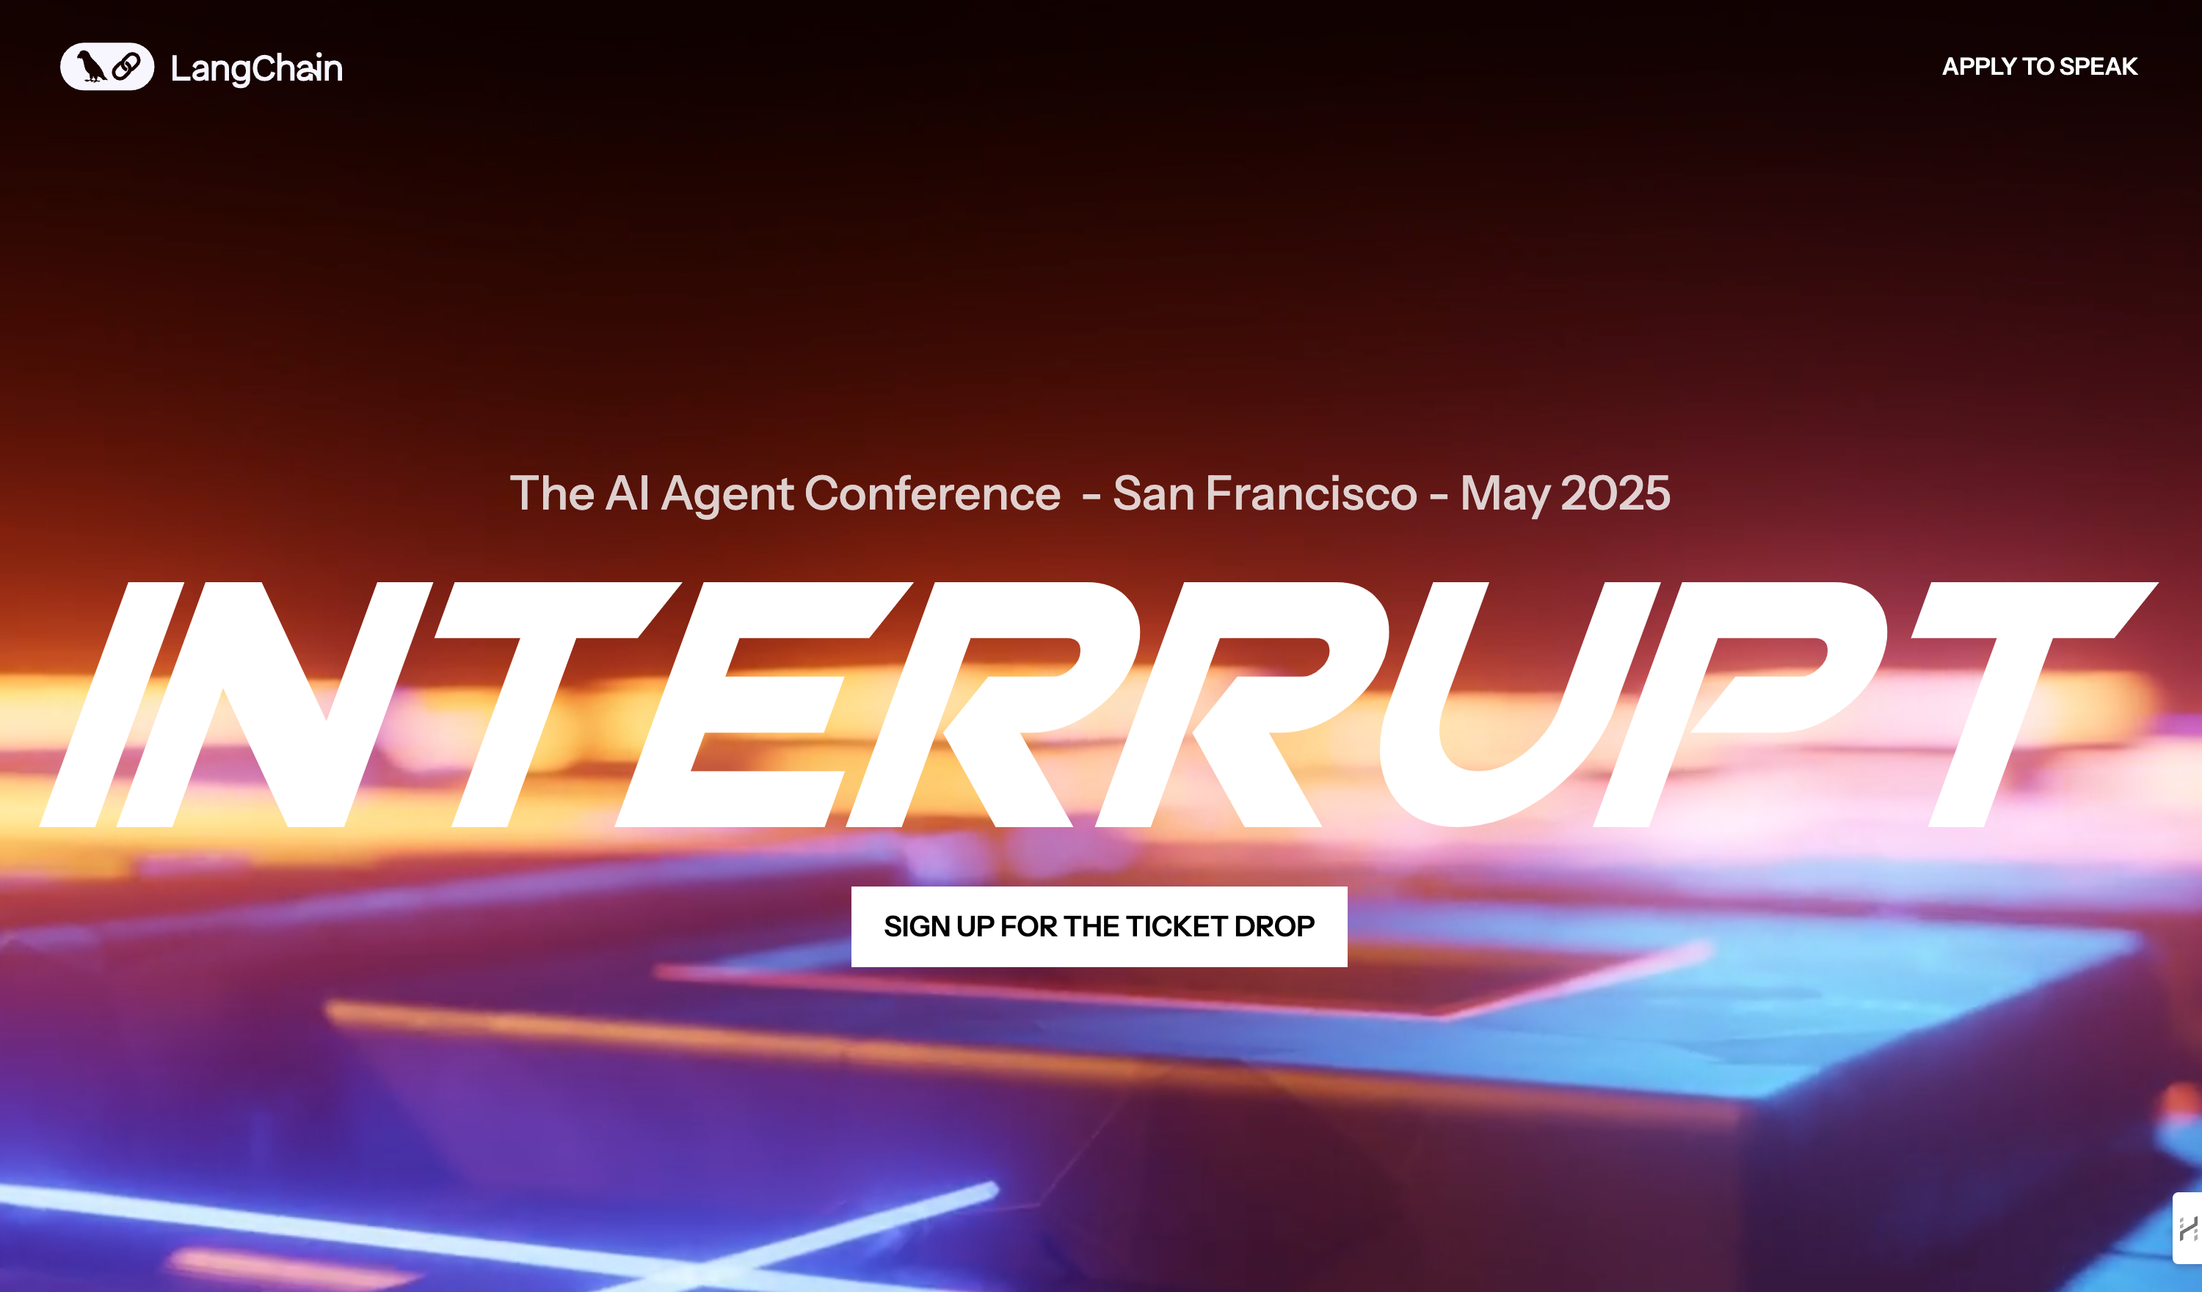
LangGraph : Command
A significant advancement in agent workflows has arrived with the new 'Command' feature, enabling:
- Dynamic, edgeless agent workflows
- Flexible execution paths determined by nodes
- Enhanced multi-agent system capabilities
- Semantic search for long-term memory
- Direct tool modification of graph state

Slide 12
LangGraph – Functional API
Ability to use LangGraph features with explicit node/edge
Built-in support for human-in-the-loop
New decorators – @entrypoint, @task
Simplified Execution and Control flow
Notes:
Hear from industry leaders like Michele Catasta (President of Replit), Adam D’Angelo (Founder & CEO of Quora), and other AI luminaries

Slide 13
Cline – Plan / Act button
Plan / Act mode
Model Persistence
MCP Servers Controls
Notes:
Hear from industry leaders like Michele Catasta (President of Replit), Adam D’Angelo (Founder & CEO of Quora), and other AI luminaries

Slide 14
Austin Public
Austin LangChain AIMUG is going on TV!
Notes:
Hear from industry leaders like Michele Catasta (President of Replit), Adam D’Angelo (Founder & CEO of Quora), and other AI luminaries

Slide 15
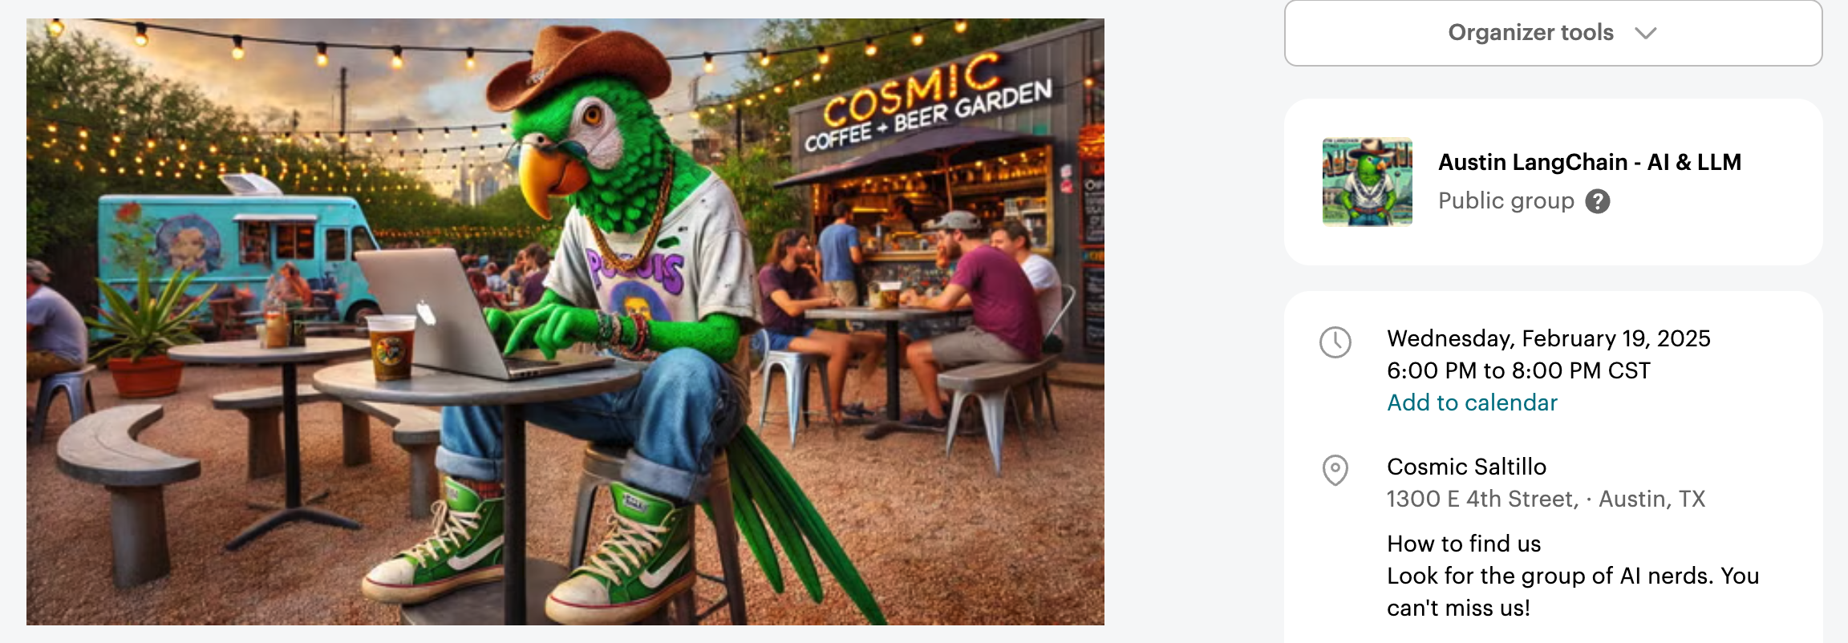
Next Event – Hacky Hour at Cosmic Coffee Saltillo

Slide 16
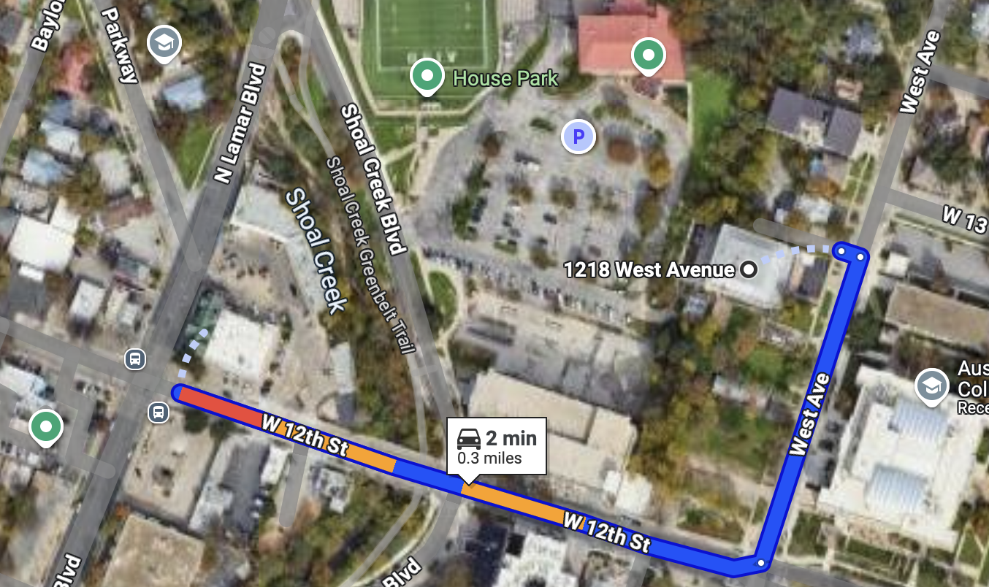
RGC-3000 and Tavern After Party (8ish)
Website: aimug.org – All things LangChain and AIMUG.
Discord: Join us for ongoing conversations.
GitHub: Austin LangChain Repo – Check out our open-source projects.
Meetup: Austin LangChain Group
Twitter: @AustinLangChain – Latest updates and AI news.
YouTube: Austin LangChain Channel – Watch replays and tutorials.
ACC RGC3000
The Tavern
ACC Main Campus

Slide 17
Showcases

Slide 18
VSCode + Cline + MCPs + LangGraph
Join Colin McNamara and Ricky Pirruccio as they demonstrate key features and functions integrating Cline, VS Code, Model Context Protocol, and LangGraph into a workflow.

Slide 19
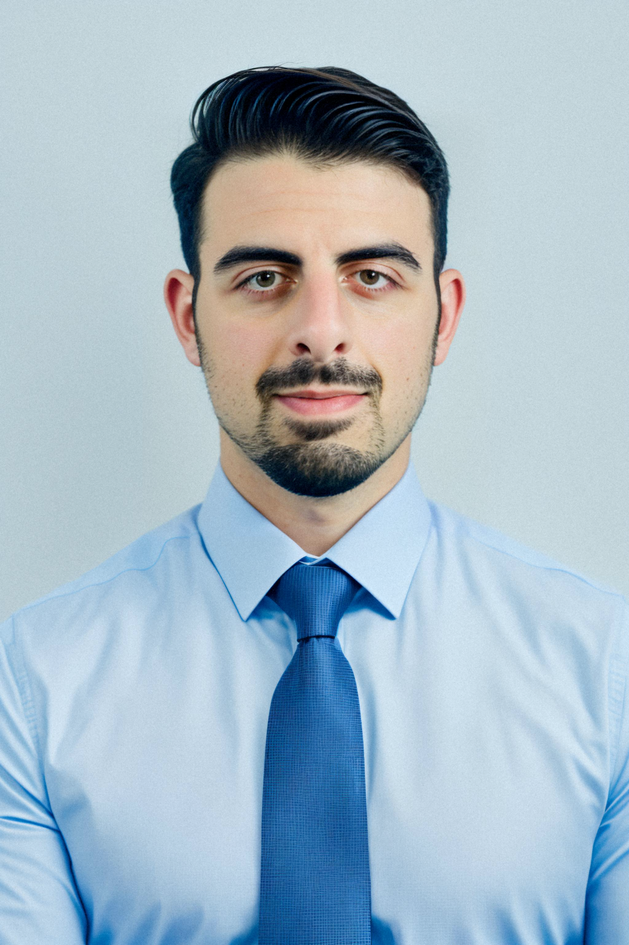

About Me - Riccardo Pirruccio
Home: Austin, Texas
Work: Technical Project Manager at Applied Materials
Background: Full Stack Engineer, Manufacturing Intelligence for Semiconductor Supply Chain
FOSS: Python, Javascript, React
Using LangChain: Filling gaps in the manufacturing supply chain process
Socials:
Linkedin https://www.linkedin.com/in/riccardopirruccio/
Github https://github.com/RPirruccio

Slide 20
Image Generation – Cloud and Local
Join Colin and Karim as they demonstrate how they use flux and other models for image generation on websites both supported by cloud and running on their local machines

Slide 21
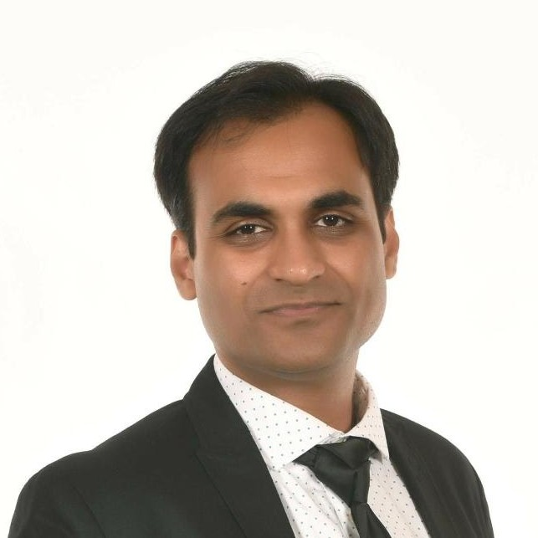

About Me - Karim Lalani
Home: Leander, Texas
Work: Software Engineer @ Office the Governor
Background: Full Stack Engineer, Machine Learning & Data Science
FOSS: Docker / Kubernetes, Java, Python
Using LangChain: Experimentation, learning
Socials:
Linkedin https://www.linkedin.com/in/-karim-lalani/
Github https://github.com/lalanikarim/
Medium https://medium.com/@klcoder

Slide 22


Slide 23
Where and when we meet 🌟📅
Monthly Showcases & Mixer - ACC RGC3000: Community members and vendors share projects, demos, and labs for hands-on learning.
Hacky Hours (Mid-Month) - Rotating Local Bars: Informal happy hours at local spots; meet, discuss, and relax.
Weekly Virtual Syncs - Online: Tuesdays & Thursdays at 2 PM – Workshopping, problem-solving, and AI discussions.

Slide 24
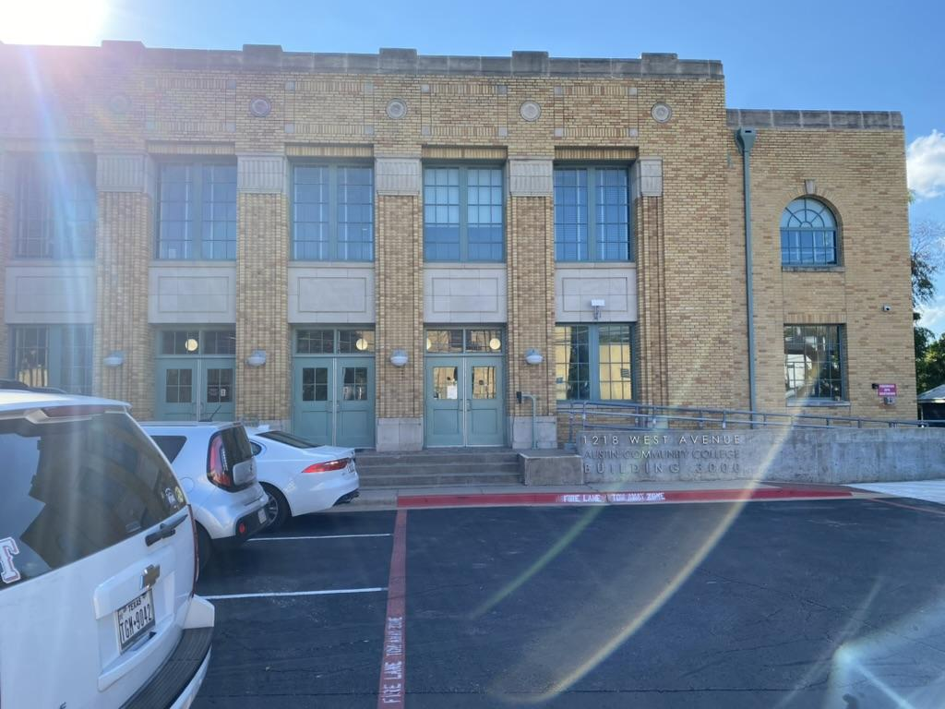
Finding US - ACC RGC-3000

Slide 25
About Me - Karim Lalani
Home: Leander, Texas
Work: Software Engineer @ Office the Governor
Background: Full Stack Engineer, Machine Learning & Data Science
FOSS: Docker / Kubernetes, Java, Python
Using LangChain: Experimentation, learning
Socials:
Linkedin https://www.linkedin.com/in/-karim-lalani/
Github https://github.com/lalanikarim/
Medium https://medium.com/@klcoder

Slide 26
Where to Connect & Stay Updated 📲
Website: aimug.org – All things LangChain and AIMUG.
Discord: Join us for ongoing conversations.
GitHub: Austin LangChain Repo – Check out our open-source projects.
Meetup: Austin LangChain Group
Twitter: @AustinLangChain – Latest updates and AI news.
YouTube: Austin LangChain Channel – Watch replays and tutorials.

